Slide 1
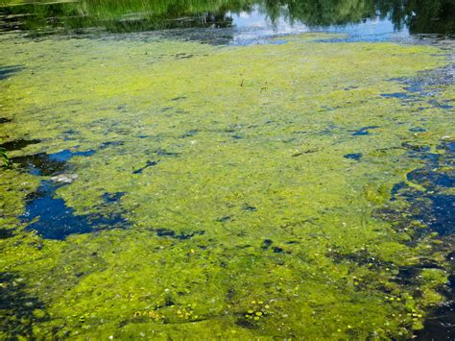
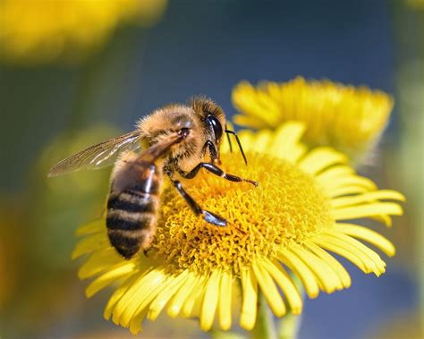
Producers and Consumers – Page 1
In the following passage, underline or highlight all the key-words and information. Then, answer the questions on the back
Producers and consumers are two important groups in any ecosystem. Producers are living things that make their own food using sunlight, water, and nutrients from the soil. They are usually plants or algae. Consumers, on the other hand, cannot make their own food, so they need to get their energy by eating other living things. Consumers can be animals, fungi, or bacteria.
Producers are the foundation of any food chain or food web. They are at the base of the food chain because they are the only organisms that can make their own food. When a consumer eats a producer, it is called a primary consumer. When a consumer eats a primary consumer, it is called a secondary consumer, and so on. This is how energy moves through the ecosystem.
Consumers can be divided into different groups based on what they eat. Herbivores are animals that eat only plants, while carnivores are animals that eat only other animals. Omnivores are animals that eat both plants and animals. Decomposers are another type of consumer. They break down dead plants and animals into nutrients that can be used by producers.
Producers and consumers are important to each other. Producers provide food and oxygen for consumers, while consumers help producers by spreading their seeds or pollinating their flowers. Without producers, there would be no food for consumers, and without consumers, producers would not be able to spread and grow.
In conclusion, producers and consumers are two important groups in any ecosystem. Understanding producers and consumers is essential for understanding how ecosystems work.

Slide 2
Producers and Consumers – Page 2
What are producers?
______________________________________________________________________
What are three things producers can get their energy from?
__________________________________________________________
__________________________________________________________
__________________________________________________________
What is a consumer?
______________________________________________________________________
How does energy move around the ecosystem?
______________________________________________________________________
What are the three types of consumers?
__________________________________________________________
__________________________________________________________
__________________________________________________________
What do decomposers do? ______________________________________________________________________
Why do consumers need producers?
______________________________________________________________________
Why do producers need consumers?
______________________________________________________________________

